Slide 1


Slide 2
Welcome to country
In the spirit of Reconciliation, HotDoc acknowledges the Traditional Custodians throughout Australia and their connections to land, sea and community.
We pay our respect to their elders past and present and extend that respect to all Aboriginal and Torres Strait Islander peoples today.

Slide 3
Before we begin -
This session is being recorded & you will be sent a link 4-6 hours after this session has concluded with the recording & resources.
Use the Q&A tool on your screen to submit a questions through the session & we will address at the end. If we don’t get a chance to address during the LIVE session, we will reach out to you afterwards to discuss further.
In the “related content” you’ll find our further feedback form.
Your certificate will be accessible at anytime, you can access via the certificate icon on your console.
Have a play around with the console/ icons on your screen, it’s an interactive experience.
Please take some time to complete our feedback survey to let us know what you thought of today’s session.

Slide 4

  Driving Better Care:
  Key Updates on Wound Consumables, Lung Cancer Screening and Better
  Access Program

Slide 5
Learning Objectives
Understand how the Chronic Wound Consumables Scheme can support practices to reduce costs around chronic wound care dressings, and the enrolment process for general practice patients.
Identify the key points in determining eligibility for patients to partake in the National Lung Cancer Screening Program and how to register.
Recall the upcoming November 1 changes around the Better Access Program.
Recognise the importance of continuous patient engagement to enrol in the MyMedicare Program to support future funding.

Slide 6
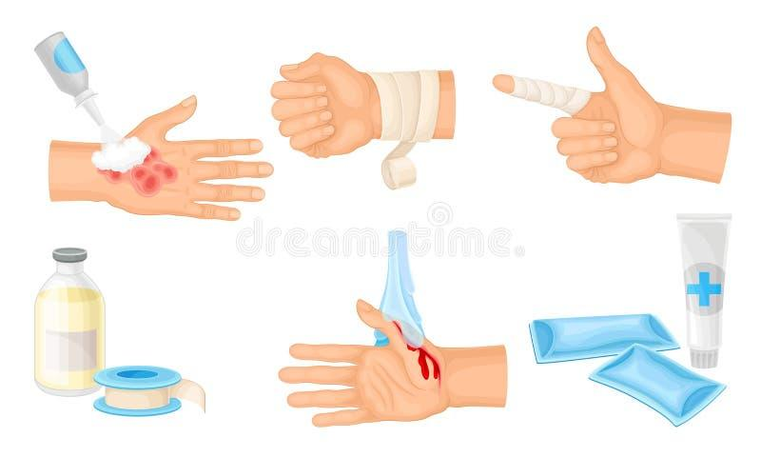
  Chronic Wound Consumables
  Scheme

Slide 7
Chronic Wound Consumables Scheme
Purpose and Background
The National Wound Consumables Scheme is designed to improve access to affordable wound care for people living with chronic wounds.
Chronic wounds are a significant and growing health issue, particularly among older Australians and those with chronic conditions such as diabetes or vascular disease.
These wounds often require long-term management and can lead to serious complications if not treated properly.

Slide 8
Chronic Wound Consumables Scheme
The scheme recognises that many patients face high out-of-pocket costs for wound dressings and related supplies, which can result in delayed or suboptimal care.
The program aims to remove these financial barriers and promote consistent, evidence-based wound management in the community.
Also designed to assist practices to combat the high costs of providing “best practice” dressings and consumables.

Slide 9
Chronic Wound Consumables Scheme
The key objectives of the scheme are:
Improve access and affordability of clinically appropriate wound consumables.
Support early intervention and ongoing management of chronic wounds in primary care.
Reduce hospital admissions related to preventable wound complications.
Promote best-practice wound care through national consistency and collaboration across sectors.
Enable practice nurses and GPs to deliver more comprehensive wound care within general practice settings.

Slide 10
Chronic Wound Consumables Scheme
What the Scheme Covers
The scheme provides subsidised access to a nationally agreed list of wound consumables, including:
Advanced and basic wound dressings (e.g., foam, hydrocolloid, alginate, and antimicrobial dressings).
Compression bandages and support materials for venous ulcers.
Tapes, fixation, and secondary dressings.
Cleansing products and protective barrier preparations.

Slide 11
Chronic Wound Consumables Scheme
The product list has been developed in consultation with:
  clinical experts,
  wound care specialists, and
  professional nursing organisations to ensure it reflects evidence-based best practice

Slide 12
Chronic Wound Consumables Scheme
Eligibility and Access
The scheme primarily targets:
Older Australians (65+) with diabetes and;
First Nations person aged 50 or over with:
chronic conditions causing non-healing wounds for patients receiving care through
  general practices,
  community health services, or
  Aboriginal Community Controlled Health Organisations (ACCHOs).

Slide 13
Chronic Wound Consumables Scheme
Access to scheme will typically involve:
Assessment by a GP or practice nurse to confirm wound type and management plan.
Registration or referral through a participating provider.
Provision of subsidised consumables either directly through the practice or via a partnered pharmacy or supplier.

Slide 14
Chronic Wound Consumables Scheme
Benefits For patients:
Reduces or removes the financial burden of wound dressings.
Promotes faster healing through consistent, evidence-based treatment.
Improves equity of access, especially in rural and remote areas.

Slide 15
Chronic Wound Consumables Scheme
Benefits for general practice:
Enables enhanced wound management services within existing chronic disease.
Encourages a team-based care model involving GPs, nurses, and allied health.
Supports continuity of care and reduces reliance on emergency or hospital-based wound services.

Slide 16
Chronic Wound Consumables Scheme
To be eligible to participate practitioners must:
Be AHPRA Registered as either a:
  Aboriginal and Torres Strait Islander health practitioner
  Medical practitioner in a primary care setting, including general practitioner
  Nurse (registered and nurse practitioner)
  Podiatrist.

Slide 17
Chronic Wound Consumables Scheme
To access the CWCS scheme and online ordering portal, health professionals must first complete the mandatory training by:
Enrolling and completing the online training module.
Upon completion, you’ll receive a certificate and a link to register for the CWCS portal via the Services Australia PRODA site.
Training may also count toward continuing professional development (CPD).

Slide 18
Chronic Wound Consumables Scheme
Patients will not be eligible to participate if they are receiving funding from:
Department of Veterans' Affairs programs including the RPBS.
Government-funded aged care services
National Disability Insurance Scheme (NDIS)
Public wound clinics or hospitals
Residential Aged Care Homes ( Govt funded)
Community Home Support Program (My Aged Care funded)

Slide 19
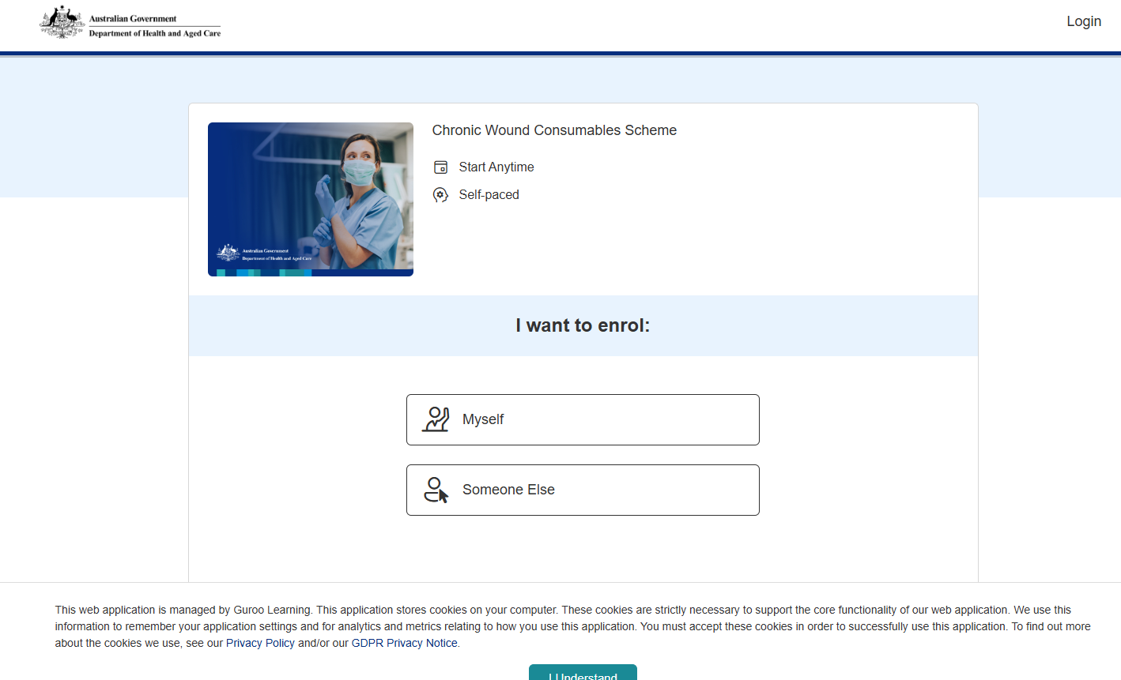

Slide 20
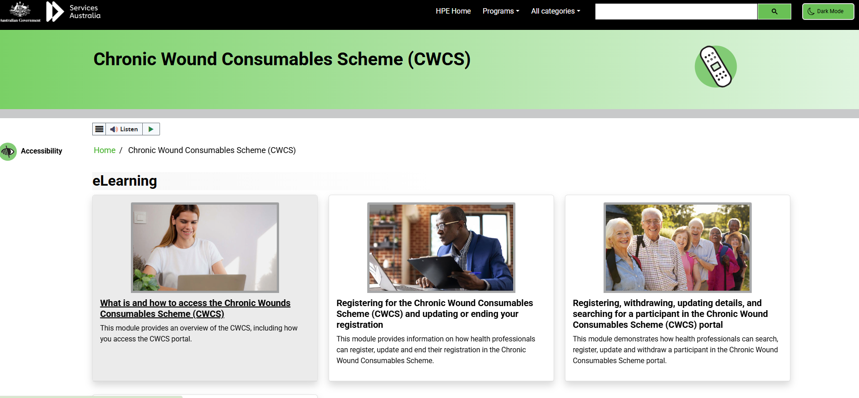

Slide 21
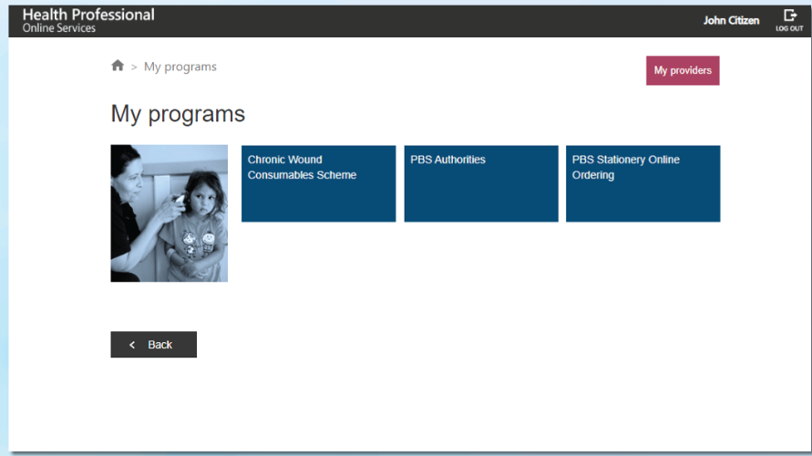

Slide 22
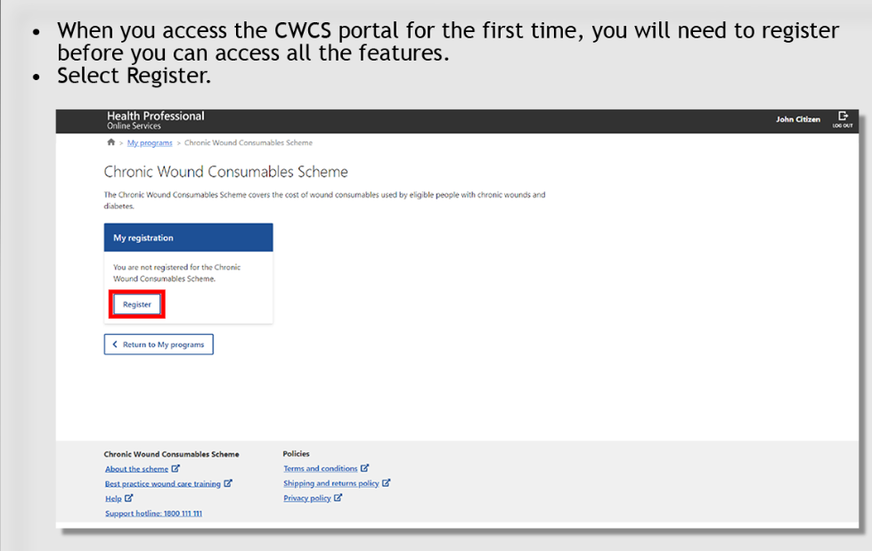

Slide 23
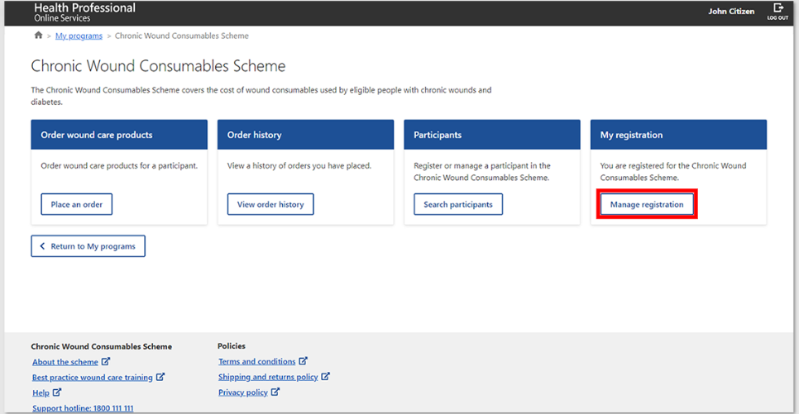

Slide 24

  National Lung Cancer
  Screening Program

Slide 25
Lung Cancer Screening
The National Lung Cancer Screening Program aims to achieve better health outcomes by detecting lung cancer early.
Early detection can lead to more effective treatment options and improved outcomes for patients.
The program screens for lung cancer in high-risk individuals using low-dose computed tomography (low-dose CT) scans.

Slide 26
Lung Cancer Screening
The program targets people with no signs or symptoms suggesting they may have lung cancer and:
  are aged between 50 to 70 years old
  who smoke tobacco cigarettes or have a history of cigarette smoking (quit within the last 10 years).
  Have a history of smoking the equivalent of a pack a day
    20 cigarettes or more
    Smoked for at least 30 years

Slide 27
Lung Cancer Screening
Researchers estimate that:
The proportion of cases identified at early-stage cancer (stage 1) will increase from 16% without a screening program to 60% with a screening program
The proportion of advanced stage (stage 4) cancer will decrease from 53% without a screening program to 11% with a screening program.

Slide 28
The screening pathway
Participants with a very low risk of cancer (no current findings) will stay in the program and receive a reminder for a repeat scan in 2 years
Participants with low-risk findings will stay in the program and return for a follow-up low-dose CT scan in 12 months
Participants with low to moderate risk findings will stay in the program and return for a follow-up low-dose CT scan in 6 months
Participants with moderate risk findings will stay in the program and return for a follow-up low-dose CT scan in 3 months

Slide 29
The screening pathway
Those with high risk and very high-risk findings will require further investigation and action:
  refer them to a respiratory physician linked to a lung cancer multidisciplinary team (MDT).
Sometimes screening can show something that is not lung cancer, that may need follow-up testing or treatment.
These participants will go back to usual care and their requesting healthcare provider will follow the relevant clinical guidelines.

Slide 30
Lung Cancer Screening
Accessing the National Cancer Screening Register
The NCSR provides information and helpful reminders about screening.
The NCSR Participant Portal allows you to:
update your personal details
manage your participation
update communication preferences (paper or electronic options)
view your screening information.

Slide 31
Lung Cancer Screening- For Patients
The NCSR also sends your patients information on what happens next or when they are due for their next scan.
Access via MyGov where they will see an option to link to the NCSR.
They will also be able to see when their last lung cancer screen was.
If they participate in the National Bowel Cancer Screening Program or the National Cervical Screening Program, information and communications about those programs is also available.
Can choose to stay in the program but opt out of receiving information from the NCSR, such as reminders to screen.

Slide 32
Lung Cancer Screening
The low-dose CT scan
There will be 2 new mandatory BB item numbers:
  1 MBS item for the screening low-dose CT scan done by the participant approximately every 2 years
  1 MBS item for any follow-up low-dose CT scans that may be required depending on the results of the screening low-dose CT scan.
Patients will not have any out-of-pocket costs for the low-dose CT scan as mandated to be Bulk billed.
Not all imaging providers are registered- check Health Pathways for further details.

Slide 33
Lung Cancer Screening
Eligibility
Aged between 50 and 70 years
show no signs or symptoms of lung cancer
currently smoke or have quit smoking in the past 10 years
Have a history of tobacco cigarette smoking of at least 30 pack-years. ( see next slide)
Healthcare providers to determine eligibility based on above criteria.
They will also assess whether you are suitable for screening based on specific criteria, which may be temporary.
For example, being able to lie down flat to complete a low-dose computed tomography (low-dose CT) scan.

Slide 34
Lung Cancer Screening
Definition of “Pack-Years” is a way of measuring the number of cigarettes a person has smoked in their lifetime.
Pack-years are calculated by multiplying the number of cigarette packs smoked per day by the number of years the person has smoked.
For example, 1 pack-year is equal to smoking 20 cigarettes (1 pack) per day for 1 year = 1 Pack year.
1 pack per day for 10 years= 10 pack years
( online calculators available to assess pack years)

Slide 35
Lung Cancer Screening
You can continue to screen even if the patient stopped smoking more than 10 years ago.
Eligible to continue in the program until:
age out (turn 71)
become unable to undergo a low-dose CT scan (which may be temporary)
have findings on scans that mean further intervention
Patients do not have to quit smoking to participate in the program.

Slide 36
Getting ready
You can prepare for the program by:
registering and integrating with the National Cancer Screening Register (NCSR)
Working with your practice to identify patients who could be eligible from July 2025, including
  reviewing and updating smoking history in your clinical patient records
  establish prompts which can help identify potential participants as they become available.

Slide 37
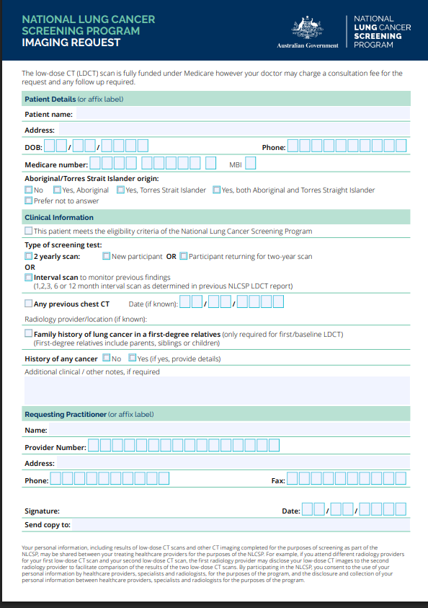

Slide 38
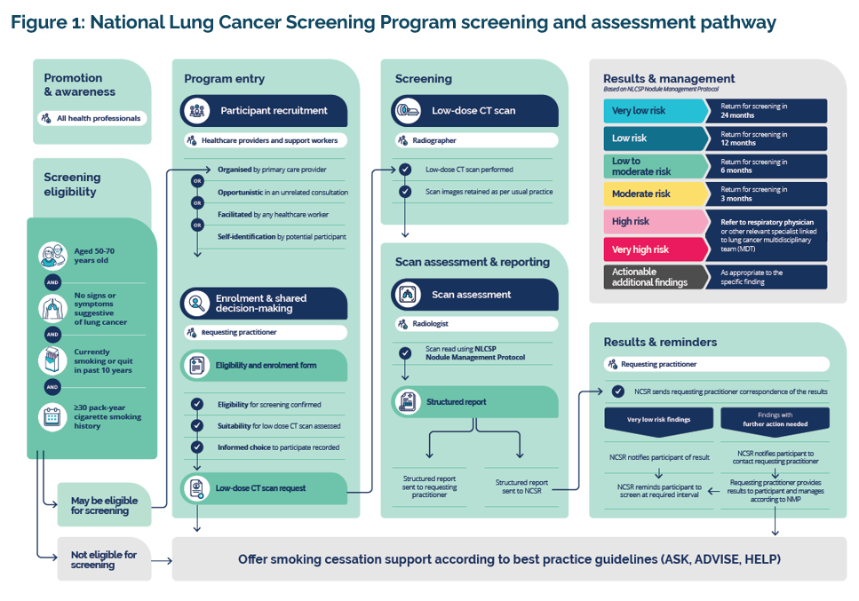

Slide 39

  Changes to Better Access
  1.11.25

Slide 40
Changes To Better Access Initiative
The Government is making some changes to the Better Access initiative to respond to the Better Access evaluation.
These changes will better meet the needs of individuals and improve equity of access.
GPs will be supported to assess the mental health needs of people and refer them to the most appropriate services.

Slide 41
Changes To Better Access Initiative
This includes referral to other services where appropriate, including:
The new national early intervention service (1/1/26)
Medicare Mental Health Centres ( only one in Victoria currently- Geelong)
An education campaign will be developed to promote awareness, trust and use of the service by referring health practitioners and consumers

Slide 42
Changes To Better Access Initiative
As recommended in the Better Access evaluation, the mental health treatment plan will be retained.
GPs will continue to be able to claim specific items to prepare a mental health treatment plan.
Mental health treatment plan review and mental health consultation items will be removed from 1 November 2025. (2712/2713)
GPs will use general attendance items to provide these services and claim the most appropriate item based on the amount of time they spend with their patients.

Slide 43
Changes To Better Access Initiative
This includes longer consultations (Level E) recognising that GPs often spend longer with their patients to provide quality mental health care.
These changes mean consultations will now likely qualify for a tripled bulk billing incentive, instead of just a single incentive.

Slide 44
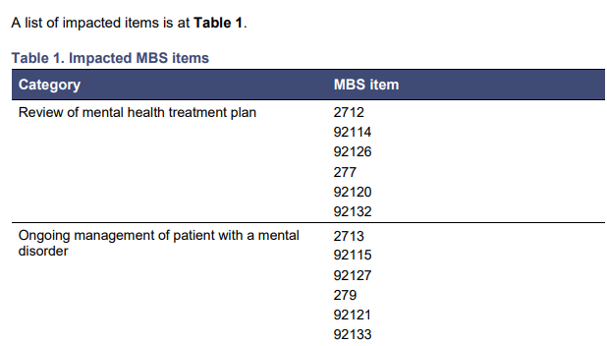
Changes To Better Access Initiative

Slide 45
Changes To Better Access Initiative
There are no changes to the number of sessions in a course of Better Access treatment.
GPs will continue to refer the patient for a course of treatment under the Mental Health Plan.
A patient can have up to a limit of 10 services in a calendar year and will need a new referral for each course of treatment, in line with current arrangements.

Slide 46
Changes To Better Access Initiative
Chronic Condition Management (CCM) Framework
In addition to a mental health plan, patients with a chronic mental health condition can also have a GPCCMP under the CCM framework
People will then be able to access five Medicare-subsidised allied health services, such as dietetics and exercise physiology services, per calendar year.
This is in addition to the 10 individual and 10 group treatment sessions available under Better Access

Slide 47
Changes To Better Access Initiative
Improving better continuity of care, from 1 November 2025, a patient can only be referred for treatment by:
Their regular GP at the practice where they are registered with for MyMedicare.
  or
Their regular GP who provides Mental Health services, even if this GP is at another practice, where they are not registered.

Slide 48

  Integrating MyMedicare enrolment to
  Practice Workflow

Slide 49
MyMedicare – part of our daily workflow
  Enrol your practice with MyMedicare in PRODA
    All the new incentives rely on registration
  Educate your staff
    Staff should be able to have the discussion with patients of benefits of registering and how
  Ensure all providers are linked to your organisation
    Patients will not be able to select regular GP if not linked
  Start the conversation with your patients
    Encourage enrolment
    Offer transparency- additional funding to practice will allow the provision of more services

Slide 50
MyMedicare – part of our daily workflow
Links to MyMedicare registration on your website
    Some online booking platforms have the link embedded in their booking system
  Handout with instructions on how to register
  Registration forms with doctors, nurses and in waiting room
  Register residents of RACH
  Access to PRODA for reception to allow enrolment and checking eligibility

Slide 51
MyMedicare – part of our daily workflow
  Checking patient enrolments
  What systems do you have in place?
  How are you identifying those who have enrolled?
  Software developers are working towards integration into PMS
    Best Practice has major enhancements coming
  Linked to My Health Record- registration status can be viewed.

Slide 52
Benefits to practice
MyMedicare registration is linked to:
Chronic Condition Management ( 1.7.25)
Better Access Initiative ( 1.11.25)
GPACI- residents of RACH

Slide 53
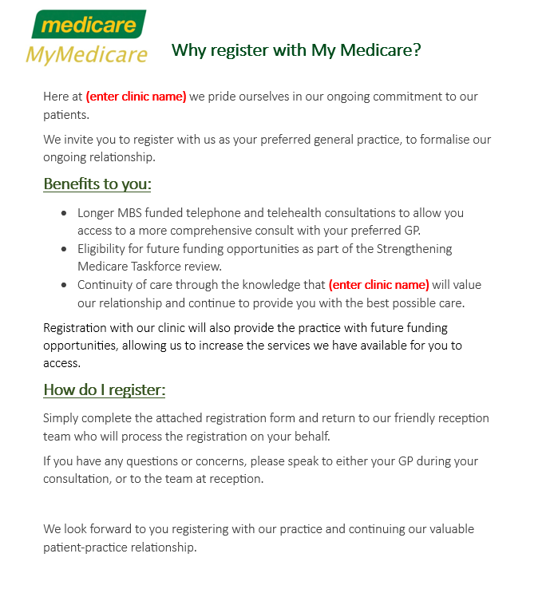

Slide 54
Resources
https://cwcs.guroo.academy/enrol/cwcs_2025
https://www.health.gov.au/resources/publications/chronic-wounds-consumable-scheme-product-list
https://www.health.gov.au/our-work/cwcs
https://www.health.gov.au/resources/publications/better-access-redesign-from-1-november-2025?language=en
https://www.mbsonline.gov.au/internet/mbsonline/publishing.nsf/650f3eec0dfb990fca25692100069854/a6bbccd4e1519234ca258d0f00120c7e/$FILE/PDF%20Version%20-%20MBS%20changes%20to%20the%20Better%20Access%20Initiative.pdf
https://www.health.gov.au/our-work/nlcsp
https://lungfoundation.com.au/protect-your-lungs/national-lung-cancer-screening-program/
https://www.health.gov.au/our-work/nlcsp/about
https://www.ncsr.gov.au/lung-program.html#:~:text=The%20National%20Lung%20Cancer%20Screening%20Program%20(NLCSP)%20commenced%201%20July,once%20enrolled%20in%20the%20program

Slide 55


Slide 56


Slide 57

Thank you for watching

