Slide 1


Slide 2


Slide 3

Before we begin -
This session is being recorded & you will be sent a link 4-6 hours after this session has concluded with the recording & resources
Find all links to additional resources including the slides are in the “related content” section on your console/ screen
Your CPD certificate will be accessible at the 40 minute mark, you can access via the certificate icon on your console
Have a play around with the console/ icons on your screen, it’s an interactive experience
Please take some time to complete our feedback survey to let us know what you thought of today’s session. You’ll be prompted at the end of the session.

Slide 4

Business Planning & Goal Setting
For Primary Health Care
Notes:
Stagnant revenue
Modified Monash Model boundaries
Districts of workforce priority
Medicare confusion
Patient expectations
Rising business costs
Cyber threats
These are just a few of the headaches that you contend with on a daily basis. And that’s happening whilst you’re dragged away because the printer isn’t working
How do we juggle the complexity of our jobs, our workplaces and staff and ensure that the ship is sailing to the destination of our choosing, rather than via a rudderless floating in the ocean?
I’m hoping to give you some structure in today’s workshop to show you the benefits of structured goal setting and business planning
Goal setting and business planning’s
Quality of life for our customers/patients
It’s about people
Shocking fact!
Tell a story!
Every day just being busy
Lack of structure/purpose
Make same mistakes repeatedly
Life lessons

Slide 5





Session Overview
RACGP Standard 3 – Practice governance & management
Goal Setting| Business Planning
How do I start?
Reporting on your plan
© Medical Business Services

Slide 6
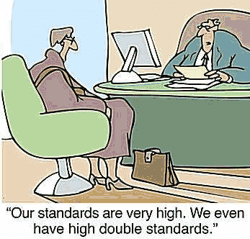
5th Edition RACGP Standard 3
Practice governance & management
“Our practice has integrated governance and management systems that maintain and improve the quality of care provided to patients”
…must meet intent of Standard, with flexibility on ‘how’
© Medical Business Services

Slide 7
(Poll question)
What best describes your practice planning activities currently
Written action planning/goal setting/QI activities
We have a business plan
We have undertaken strategic planning
Nothing formal – looking to get started

Slide 8

5th Edition Standard 3 - Indicators
C3.1A 🚩 Our practice plans and sets goals aimed at improving our services
C3.1B Our practice evaluates its progress towards achieving its goals
C3.1C 🚩 Our practice has a business risk management system that identifies, monitors and mitigates risks in the practice
C3.1D 🚩 Our practice has a complaints resolution process
© Medical Business Services
Notes:
Work towards a common goal – team
More structured

Slide 9





What is business planning?
ACHIEVING BUSINESS GOALS / OBJECTIVES
MEASURE PROGRESS
PROACTIVE PLAN FOR CHANGE
ENVIRONMENT FOR DELIVERY OF QUALITY CARE
© Medical Business Services

Slide 10
Planning Hierarchy
Mission
  Why we exist/What we do
STRATEGIC PLAN
Vision
  What we want to be
Values
  What we believe in
Strategic goals
  What we must achieve to get there
Objectives
  Specific outcomes
ACTION PLAN
Action Plan
  Planned actions to achieve objectives
Performance Measures (KPIs)
  Indicators of success
© Medical Business Services

Slide 11

Goal Setting & Action Planning
Appropriate for smaller practices
Starting out
Limited staff resources
Informal business structure
S.M.A.R.T. Goals
P.D.S.A. cycles
QI - PIP
© Medical Business Services

Slide 12

Strategic Business Plan
Suitable for any size practice
More formal
Some experience with goal setting
Basic to advanced plan
  Build on the plan as you go
  Start small
  Focus areas
Think of structure – easy to use
Excel is your friend!
© Medical Business Services

Slide 13



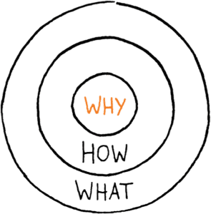

Goals, Planning & Strategy
Strategic Differentiation
Strategic Thinking
What makes you different? Market Analysis
Where do we play?
How do everyday actions impact?
Ongoing team involvement
Business Transformation
Regular review
Re-alignment
Business Plan
Team Engagement
Mission, Vision, Values, Goals, Objectives, Activities
What’s my role?
Communication
© Medical Business Services

Slide 14

Where to start?
ANALYSIS!
  Data!!
  Tap into your team
  Ask your patients
  Meet, discuss, question, prompt
  Use tools to frame your questions
  Informs your business plan
© Medical Business Services
Notes:
What has happened in the last year at your practice?
What can you learn from them?
Involve the team – teach your practice principals!
Input from many stakeholders
Use practice DATA
MUST be meaningful

Slide 15
STRENGTHS
WEAKNESSES
15
What are we good at?
What is our market advantage?
What are our challenges?
Blind spots?
Limitations?
SWOT
ANALYSIS
Threats
Competitors?
What stands in our way?
Opportunities
What can we do that we are currently not doing?
Easy wins & stretch goals

Slide 16

P.E.S.T Analysis
Political
Economic
Socio-cultural
Technological
Macro environmental impacts on your practice
Understanding growth, decline, business position
Potential directions for next actions
© Medical Business Services

Slide 17

SMART Goals & Actions
  What does success look like?
Specific
Measurable
Achievable
Realistic
Time specified

Slide 18

SMART Goal - Example
Goal: To be informed about financial performance on a constant basis and therefore able to respond to issues quickly
Activity 1: Using practice data, we will analyse our monthly revenue for each doctor by tracking, & reporting results
Performance Measure: The results will be reported by the Practice Manager to the practice principals on a quarterly basis
© Medical Business Services
Notes:
For each goal, think about the resources you might need to achieve outcome.
Rate likelihood of success /10
Chunk it down

Slide 19

Where to from here?
Take back to your team
Involve others in SWOT/Activity planning
  More ideas to the table
  Collaborative approach
  Team building
  Increase chance of success
Define structure for your plan
© Medical Business Services

Slide 20
Format of your Plan
One page plan
  Mission, Vision, Values statement
  High level initiatives, outcomes, measures, activities
  Easy to communicate (staff and other stakeholders)
  ‘Road map’
  Who is audience?
© Medical Business Services

Slide 21
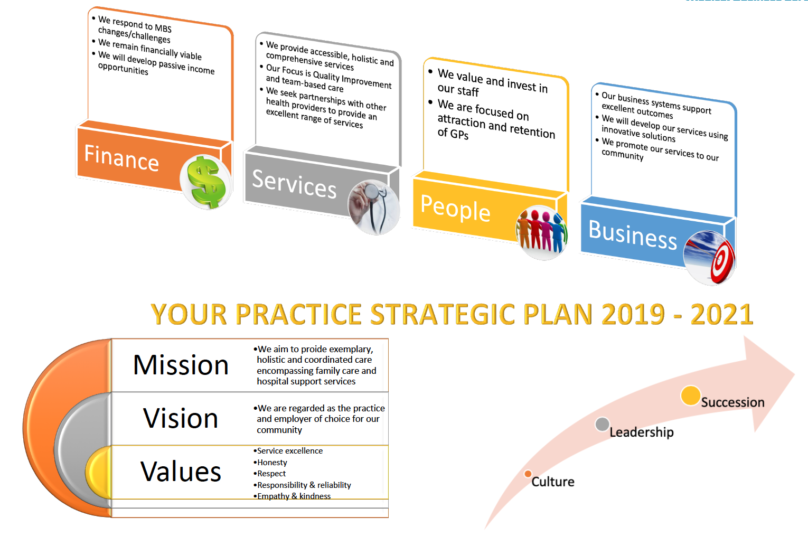
Your Practice Plan 2025 - 2026
© Medical Business Services

Slide 22
Format of your Business | Action Plan
Operational plan
SMART goals
PDSA cycles
What / Who / When / How
© Medical Business Services

Slide 23
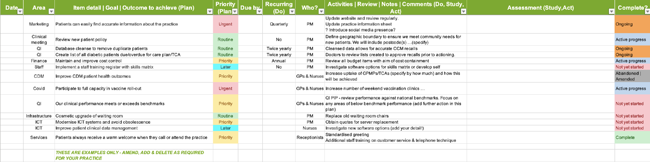
Business Plan | Download Template!

Slide 24

Reporting on your plan
Format in line with requirements for your business
Examples
  Quarterly planning meetings
  Report on activities and outcomes
    Accountability
    Systems approach
    Spreadsheets are easy to use for this!
  Has anything changed?
    Responsive
    Warning signs
    Update strategic / business / operational plans
© Medical Business Services

Slide 25

Key messages
Planning has many components
Big picture thinking
Systems approach
Involve the whole team
Appropriate plans for your business
Analysis & interpretation
Regular reporting and review
The first one is the hardest! Start now…
© Medical Business Services

Slide 26

© Medical Business Services

Slide 27
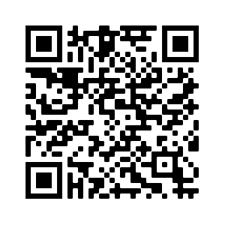
Resources & Further Information
https://www.medicalbusiness.services/business-planning-request
SWOT & PEST Analysis | FREE templates
Simple Business Plan | Action Plan FREE template
  Practice Management & Risk Register Information
eLearning & Membership
  eLearning Modules & Programs
  Practice Management Fundamentals Masterclass Membership
© Medical Business Services

Slide 28


Slide 29


